Slide 1
Linear search
Mack 2022
Notes:
Last updated: 12-2-2022

Slide 2

Searching for a book
Starter activity
Think about how you would instruct someone to find a book:
On a randomly ordered bookcase in someone’s bedroom
In the fiction section at a library
Question: Would the instructions be the same in both cases?
Think, write, pair, share.

Slide 3

Lesson 46: Linear search
Objectives
In this lesson, you will:
Identify why computers often need to search data
Describe how linear search is used for finding the position of an item in a list of items
Perform a linear search to find the position of an item in a list

Slide 4

Searching for an item
Activity 1
Whenever there are lots of items, it’s important to be able to find the one you need.
For instance, you might need to look through a clothing rail to find an item in your size or search through a pack of cards for a particular card.

Slide 5
Searching for an item
Activity 1
Computers need to search through sequences of data all the time, such as trying to find a file with a particular name on your computer.
Another example is using a search engine to find websites on the internet that match certain keywords.
When faced with a search problem, you will either have to deal with ordered or unordered sequences of data.

Slide 6

Linear search
Activity 2
Linear search is an algorithm that involves checking each item in a list or sequence of data one at a time (hence “linear”) to see if it’s the right item.
If you have a list that is not in order, a linear search is the only reasonable way to search through it.
In the next slides, you will see an example of how to perform a linear search.

Slide 7
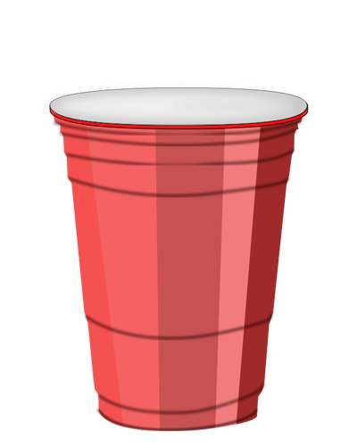
Linear search
Activity 2
Each number is hidden under a cup. The cups are arranged in a random order. From the cups, the number to find is 126.
Cup 1
Cup 2
Cup 3
Cup 4
Cup 5
Cup 6
Cup 7
Cup 8
Cup 9
27
358
62
9
412
126
81
175
408
Take a list of data and an item that is being searched for (the search item).
Notes:
Image source: https://publicdomainvectors.org/en/free-clipart/Plastic-cup-vector-drawing/8998.html

Slide 8
Linear search
Activity 2
Each number is hidden under a cup. The cups are arranged in a random order. From the cups, the number to find is 126.
Cup 1
Cup 2
Cup 3
Cup 4
Cup 5
Cup 6
Cup 7
Cup 8
Cup 9
27
358
62
9
412
126
81
175
408
current
Start from the first item in the list.
Notes:
Image source: https://publicdomainvectors.org/en/free-clipart/Plastic-cup-vector-drawing/8998.html

Slide 9
Linear search
Activity 2
Each number is hidden under a cup. The cups are arranged in a random order. From the cups, the number to find is 126.
Cup 1
Cup 2
Cup 3
Cup 4
Cup 5
Cup 6
Cup 7
Cup 8
Cup 9
27
358
62
9
412
126
81
175
408
current
Compare the item at the current position to the search item.
Notes:
Image source: https://publicdomainvectors.org/en/free-clipart/Plastic-cup-vector-drawing/8998.html

Slide 10
Linear search
Activity 2
Each number is hidden under a cup. The cups are arranged in a random order. From the cups, the number to find is 126.
Cup 1
Cup 2
Cup 3
Cup 4
Cup 5
Cup 6
Cup 7
Cup 8
Cup 9
27
358
62
9
412
126
81
175
408
current
If it is not the item you are searching for, go to the next item in the list.
Notes:
Image source: https://publicdomainvectors.org/en/free-clipart/Plastic-cup-vector-drawing/8998.html

Slide 11
Linear search
Activity 2
Each number is hidden under a cup. The cups are arranged in a random order. From the cups, the number to find is 126.
Cup 1
Cup 2
Cup 3
Cup 4
Cup 5
Cup 6
Cup 7
Cup 8
Cup 9
27
358
62
9
412
126
81
175
408
current
Compare the item at the current position to the search item.
Notes:
Image source: https://publicdomainvectors.org/en/free-clipart/Plastic-cup-vector-drawing/8998.html

Slide 12
Linear search
Activity 2
Each number is hidden under a cup. The cups are arranged in a random order. From the cups, the number to find is 126.
Cup 1
Cup 2
Cup 3
Cup 4
Cup 5
Cup 6
Cup 7
Cup 8
Cup 9
27
358
62
9
412
126
81
175
408
current
If it is not the item you are searching for, go to the next item in the list.
Notes:
Image source: https://publicdomainvectors.org/en/free-clipart/Plastic-cup-vector-drawing/8998.html

Slide 13
Linear search
Activity 2
Each number is hidden under a cup. The cups are arranged in a random order. From the cups, the number to find is 126.
Cup 1
Cup 2
Cup 3
Cup 4
Cup 5
Cup 6
Cup 7
Cup 8
Cup 9
27
358
62
9
412
126
81
175
408
current
Compare the item at the current position to the search item.
Notes:
Image source: https://publicdomainvectors.org/en/free-clipart/Plastic-cup-vector-drawing/8998.html

Slide 14
Linear search
Activity 2
Each number is hidden under a cup. The cups are arranged in a random order. From the cups, the number to find is 126.
Cup 1
Cup 2
Cup 3
Cup 4
Cup 5
Cup 6
Cup 7
Cup 8
Cup 9
27
358
62
9
412
126
81
175
408
current
If it is not the item you are searching for, go to the next item in the list.
Notes:
Image source: https://publicdomainvectors.org/en/free-clipart/Plastic-cup-vector-drawing/8998.html

Slide 15
Linear search
Activity 2
Each number is hidden under a cup. The cups are arranged in a random order. From the cups, the number to find is 126.
Cup 1
Cup 2
Cup 3
Cup 4
Cup 5
Cup 6
Cup 7
Cup 8
Cup 9
27
358
62
9
412
126
81
175
408
current
Compare the item at the current position to the search item.
Notes:
Image source: https://publicdomainvectors.org/en/free-clipart/Plastic-cup-vector-drawing/8998.html

Slide 16
Linear search
Activity 2
Each number is hidden under a cup. The cups are arranged in a random order. From the cups, the number to find is 126.
Cup 1
Cup 2
Cup 3
Cup 4
Cup 5
Cup 6
Cup 7
Cup 8
Cup 9
27
358
62
9
412
126
81
175
408
current
If it is not the item you are searching for, go to the next item in the list.
Notes:
Image source: https://publicdomainvectors.org/en/free-clipart/Plastic-cup-vector-drawing/8998.html

Slide 17
Linear search
Activity 2
Each number is hidden under a cup. The cups are arranged in a random order. From the cups, the number to find is 126.
Cup 1
Cup 2
Cup 3
Cup 4
Cup 5
Cup 6
Cup 7
Cup 8
Cup 9
27
358
62
9
412
126
81
175
408
current
Compare the item at the current position to the search item.
Notes:
Image source: https://publicdomainvectors.org/en/free-clipart/Plastic-cup-vector-drawing/8998.html

Slide 18
Linear search
Activity 2
Each number is hidden under a cup. The cups are arranged in a random order. From the cups, the number to find is 126.
Cup 1
Cup 2
Cup 3
Cup 4
Cup 5
Cup 6
Cup 7
Cup 8
Cup 9
27
358
62
9
412
126
81
175
408
current
If it is not the item you are searching for, go to the next item in the list.
Notes:
Image source: https://publicdomainvectors.org/en/free-clipart/Plastic-cup-vector-drawing/8998.html

Slide 19
Linear search
Activity 2
Each number is hidden under a cup. The cups are arranged in a random order. From the cups, the number to find is 126.
Cup 1
Cup 2
Cup 3
Cup 4
Cup 5
Cup 6
Cup 7
Cup 8
Cup 9
27
358
62
9
412
126
81
175
408
current
Compare the item at the current position to the search item.
Notes:
Image source: https://publicdomainvectors.org/en/free-clipart/Plastic-cup-vector-drawing/8998.html

Slide 20
Linear search
Activity 2
Each number is hidden under a cup. The cups are arranged in a random order. From the cups, the number to find is 126.
Cup 1
Cup 2
Cup 3
Cup 4
Cup 5
Cup 6
Cup 7
Cup 8
Cup 9
27
358
62
9
412
126
81
175
408
current
If the item at the current position is equal to the search item, then stop searching.
Notes:
Image source: https://publicdomainvectors.org/en/free-clipart/Plastic-cup-vector-drawing/8998.html

Slide 21
Algorithm for linear search
Activity 2
The instructions for performing a linear search can be written as:
Take a list of data and an item that is being searched for (the search item)
Repeat steps a-c starting from the first item in the list, until you find the search item or until the end of the list is reached:
Compare the item at the current position to the search item
If the item at the current position is equal to the search item, then stop searching.
Otherwise, go to the next item in the list.

Slide 22


Searching shuffled cards
Activity 3
You are now going to perform a linear search on a set of cards:
Take 10 cards and choose a card to search for
Shuffle the cards thoroughly
Place 6 of the 10 cards face down in a single row without looking at them
Perform a linear search for your chosen card and fill in the table
Rules: you can only turn over one card at a time. You must turn it back over after each comparison.
Follow the instructions in groups of 2 or 3 and answer the questions on the Activity 3 worksheet.

Slide 23
Performance of an algorithm
Activity 4
In the last activity, you may have noticed that the amount of cards you had to compare to your search card wasn’t always the same.
In computer science, it is useful to know how long an algorithm may take to complete under different scenarios.
The number of steps an algorithm needs to perform depending on the input data can be expressed as the best and worst-case scenario.

Slide 24






Best-case scenario
Activity 4
The best-case scenario occurs when the item you are looking for results in the smallest possible number of steps.
In the case of linear search, this happens when the item you are looking for is the very first one in the list.
Best-case

Slide 25
Worst-case scenario
Activity 4
The worst-case scenario takes place when the item you are looking for results in the greatest possible number of steps.
With linear search, this happens when the item you are looking for is the very last one in the list or it isn’t in the list at all.
Worst-case

Slide 26
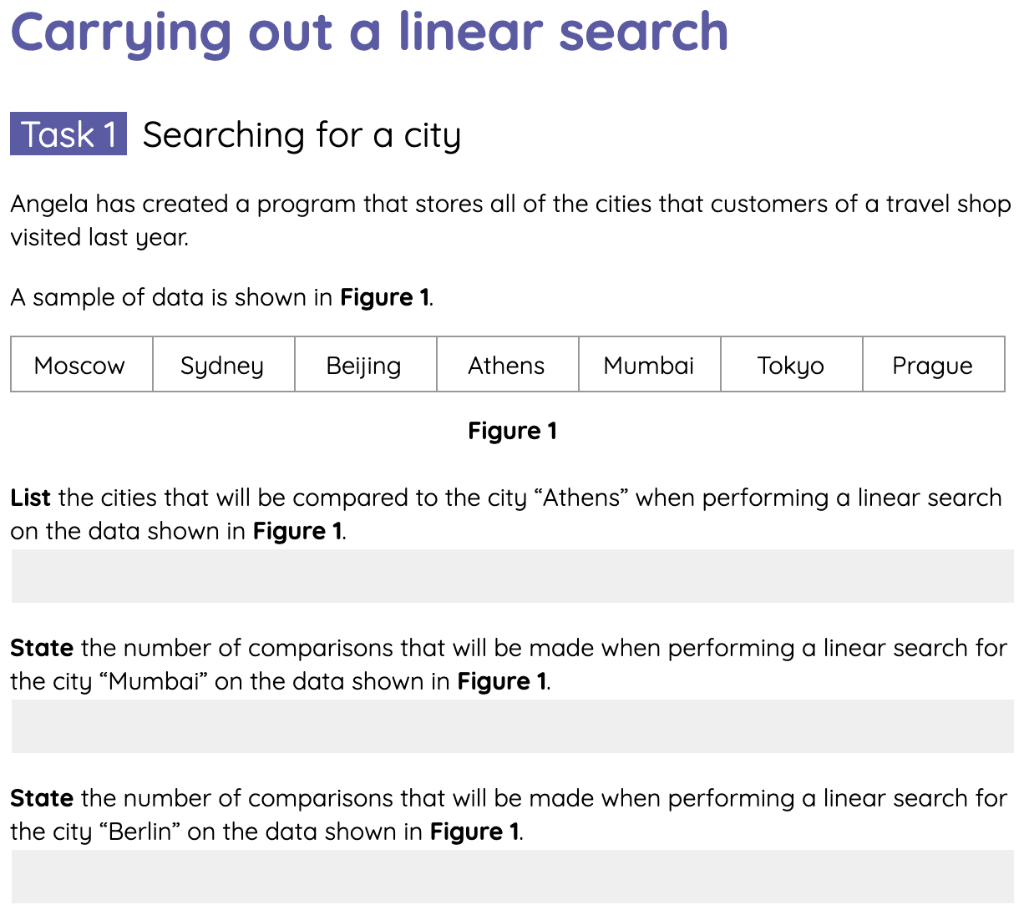
Carrying out a linear search
Activity 4
Complete the tasks on the Activity 4 worksheet for performing a linear search.

Slide 27



Best and worst-case scenario
Wrap Up
Answer the questions below when performing a linear search on these cards:
What card would you need to search for the best-case scenario to occur?
What card would give you the worst-case scenario?
How many comparisons would it take to work out that a card wasn’t in the set of cards?

Slide 28
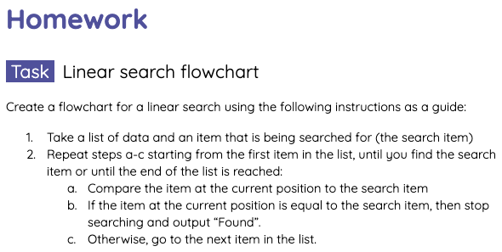
Homework: Linear search flowchart
Homework
Create a flowchart for a linear search using the instructions in the homework sheet as a guide.
Due: Next lesson

Slide 29
Next lesson
Summary
In this lesson, you…
Identified why computers often need to search data.
Described how linear search is used for finding the position of an item in a list of items.
Performed a linear search to find the position of an item in a list.
Next lesson, you will…
Investigate another searching algorithm called binary search.

